Slide 1
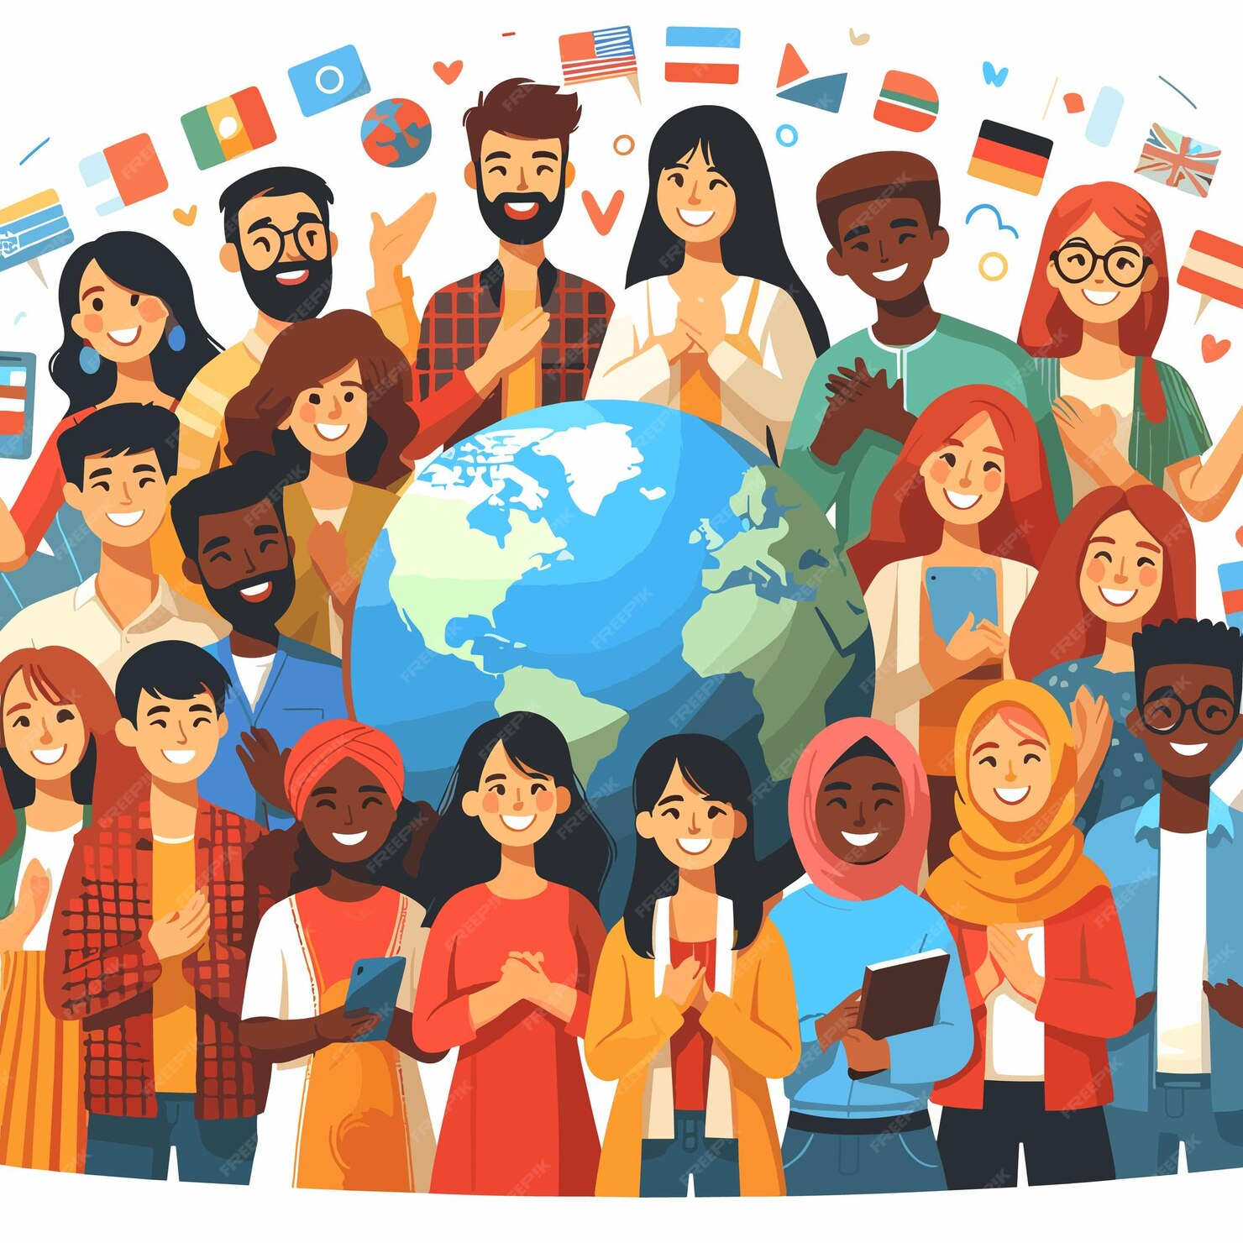
World Happiness
Report

Slide 2

The Starting Point: Measuring Happiness Worldwide
An annual landmark survey first presented in 2012 by in partnership by Gallup & UNSDSA
In response to the global demand for considering happiness & Well being as indicators for societal & economic progress
Inspired from the concept of “Gross National Happiness” in Bhutan

Slide 3
Key Indicators for Happiness
GDP
A measure of security in terms of income/employment & resources
The measure for behavior like volunteering & charity in the society
Generosity
Social Support
The availability of strong positive relationships among communities
Measures the integrity of institutions and the trust people have in them
Corruption
Health/Life Expectancy
The quality of Mental & Physical health in addition to the access to healthcare
The freedom to make life choices and the sense of empowerment for the people
Freedom

Slide 4
Dystopia
Residuals
Imaginary Society
Unexplained Components
Oppression & Control
Different for each Country
Lack of Personal Freedom
Over or Under explain each variable

Slide 5
Methodology
Data Cleaning
Understanding the Issue
Analysis (Descriptive & Bivariate)
Conclusion
Recommendation

Slide 6
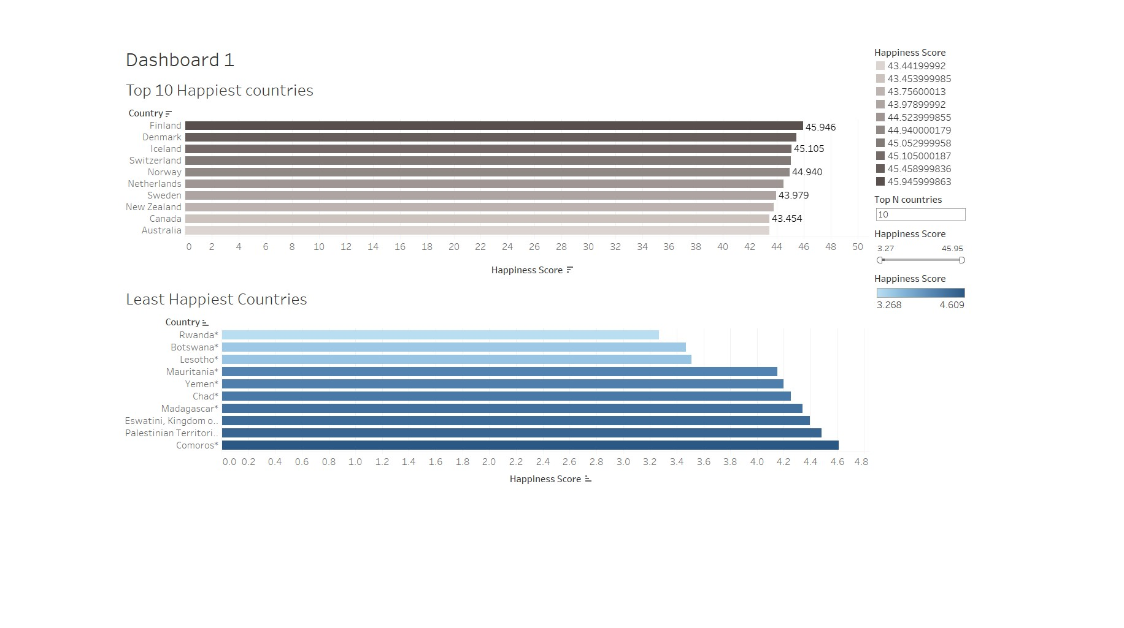
Top 10
Happiest Countries

Slide 7
Least Happiest Countries

Slide 8
Issue
Less Opportunities
Unemployment
Limited Family Support
Insufficient safety equipment during crisis
Weak Community Ties
Corruption
Inequality
Lack of Technology
Below Par Healthcare facilities
Malnutrition
Gender Inequality
Restrictions on personal freedom
Factors affecting levels of happiness
Low GDP
Low Social Support
Low Happiness Score
Low Life Expectancy
Lack of Freedom
Effects of Covid-19

Slide 9
Solutions
Encourage Fair Trade Policies
Empower Advocacy Programs
GDP
Freedom
Life Expectancy
Happiness Score
Social Support
Investment in Infrastructure
Promote Small Businesses
Promote Cultural Practices
Insurance Schemes
Invest in Public Welfare
Provide Basic Necessities
Adopt Technologies
Build a strong Education system
Equal Access to resources
Invest in Healthcare
Preventive care programs

Slide 10
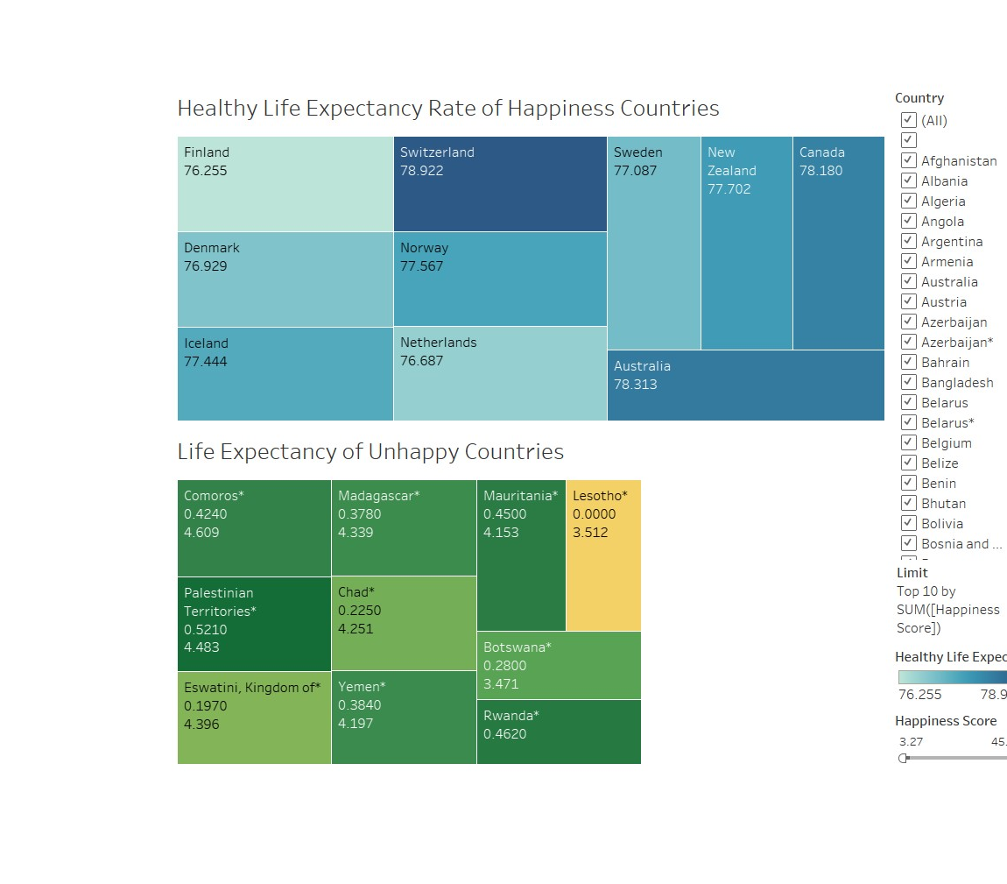
Life Expectancy

Slide 11
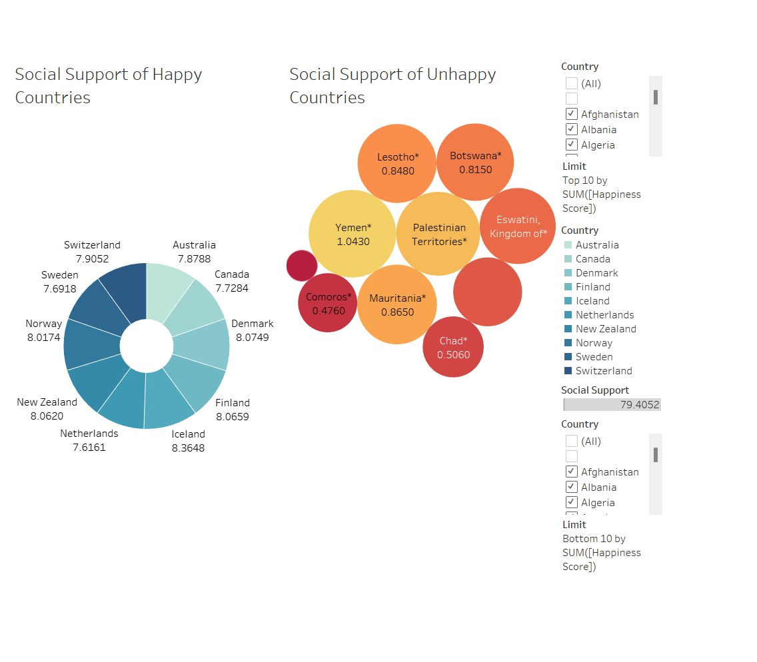
Social Support

Slide 12
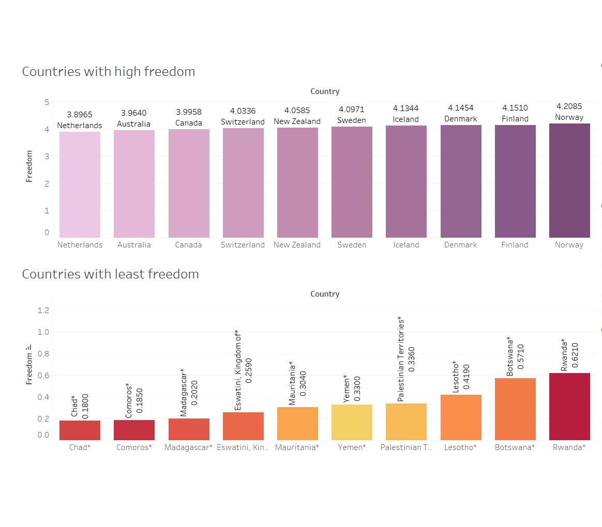
Freedom

Slide 13
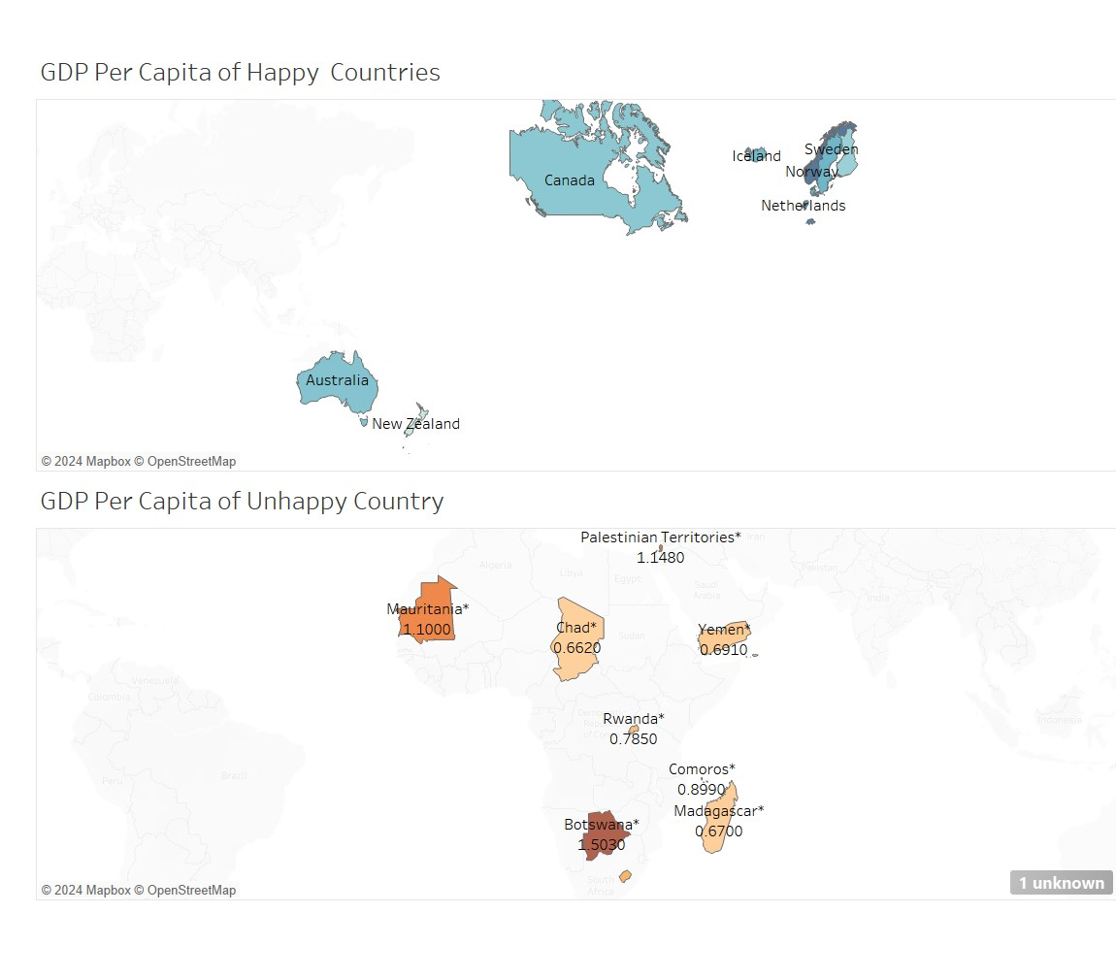
GDP

Slide 14
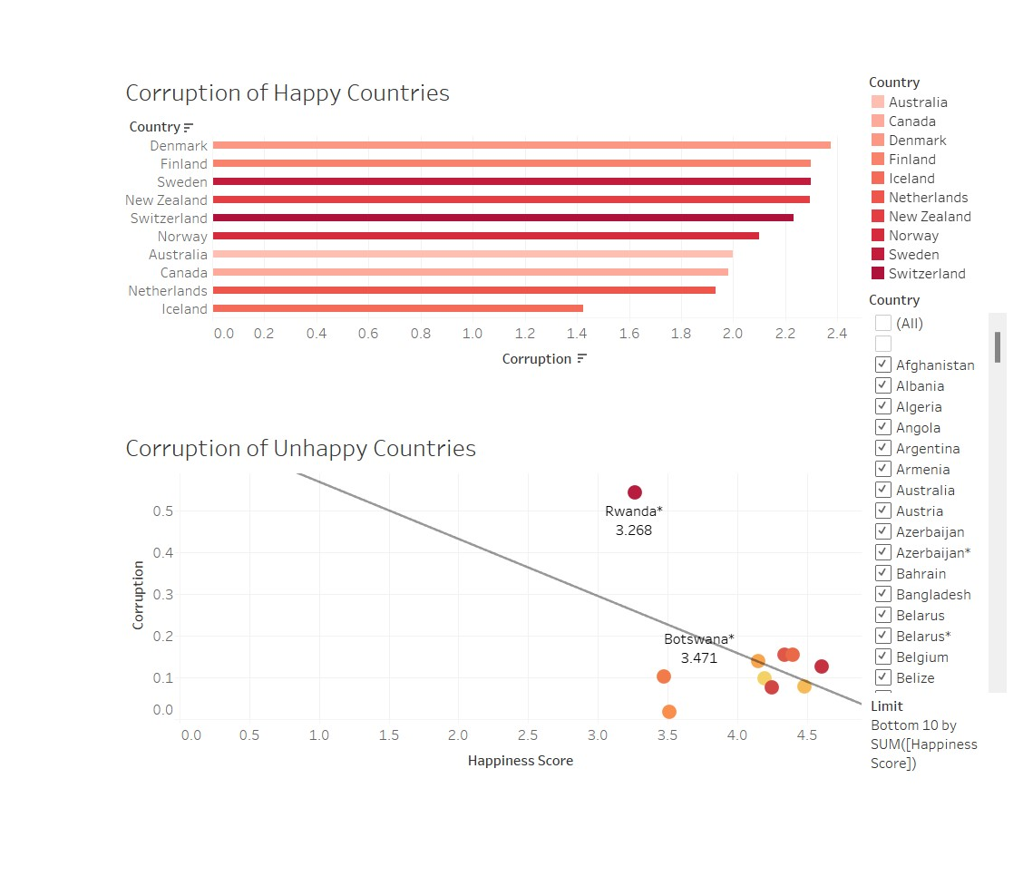
Corruption

Slide 15
Impact of the Pandemic

Slide 16
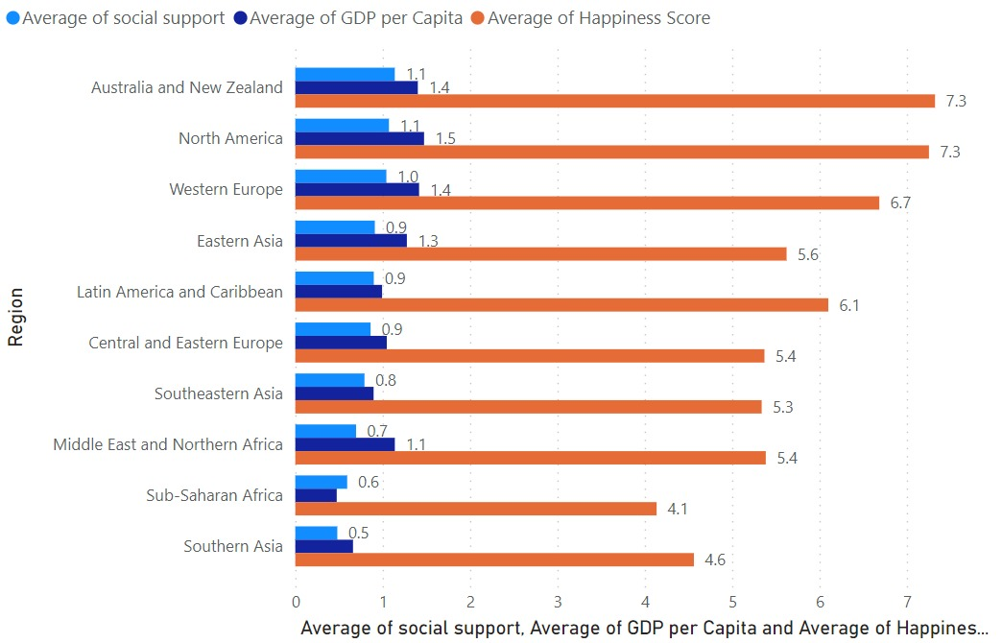
Before

Slide 17
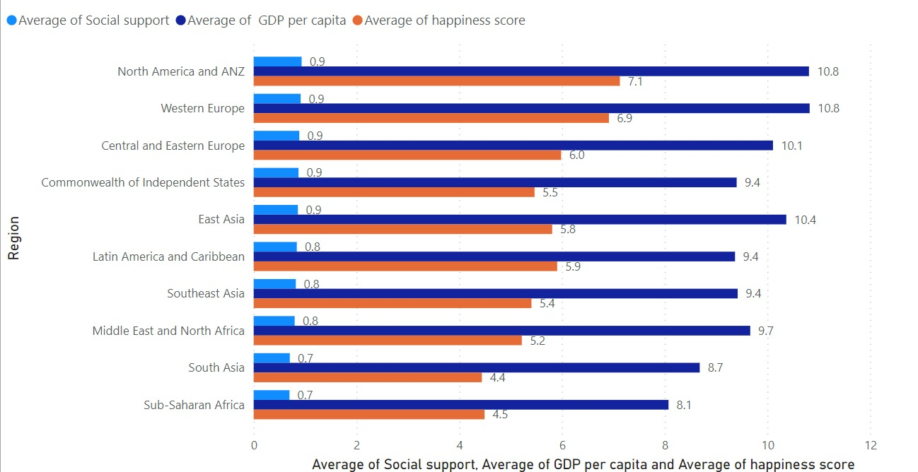
After

Slide 18
Conclusion
Happiness is driven by a combination of Economic Stability, Social Support, Trust & Healthcare Access
The common factor between happiest ranked countries like Denmark or Finland is a balance of strong economies, robust social systems and low corruption
The Pandemic highlighted the importance of social resilience and community generosity in maintaining well-being during crisis

Slide 19
Recommendations
Improve Healthcare: Invest in healthcare facilities focusing on mental & preventive care to boost life expectancy & resilience
Strengthen Social Support: Encourage community programs and welfare policies to enhance trust & reliance within societies
Enhance Economic Stability: Create opportunities for sustainable growth through job opportunities, fair wages and entrepreneurship support
Build Governance Trust: Foster transparency and combat corruption to improve public confidence in institutions
Promote Generosity: Support community-driven initiatives, volunteerism and corporate social responsibility to strengthen social bonds

Slide 20
References
Gallup, the Oxford Wellbeing Research Centre, the UN Sustainable Development Solutions Network, and the WHR's Editorial Board. (2024) World Happiness Report: About. [Online]
Available from https://worldhappiness.report/about/ [Accessed 19 November 2024]
Gallup, the Oxford Wellbeing Research Centre, the UN Sustainable Development Solutions Network, and the WHR's Editorial Board. (2024) World Happiness Report: FAQ. [Online]
Available from https://worldhappiness.report/faq/ [Accessed 19 November 2024]
Gallup. [2024] Analytics: Human Development Goals. [Online]
Available from https://www.gallup.com/analytics/318350/human-development-goals.aspx [Accessed 21 November 2024]
Helliwell, J.F., Layard, R. & Sachs, J. (eds.) 2021, World Happiness Report, available at: https://worldhappiness.report [Accessed 24 Nov. 2024].
WHO Global Health Observatory, Data and statistics, available at: https://www.who.int/data/gho [Accessed 24 Nov. 2024].
United Nations, Sustainable Development Goals, available at: https://www.un.org/sustainabledevelopment/sustainable-development-goals/ [Accessed 24 Nov. 2024].
WHO Global Health Observatory, Health and well-being, available at: https://www.who.int/data/gho/data/major-themes/health-and-well-being [Accessed 24 Nov. 2024].

